Slide 1


Welcome to TrackFlow:
Discover TrackFlow, a lightweight CRM and operations process automation tool designed to streamline your business. We aim to simplify sales and order management for startups and small teams, providing a user-friendly and efficient solution.
by Suneeth S

Slide 2
TrackFlow: Simplifying Sales & Order Management
Lightweight CRM
Automated Workflows
User-Friendly UI
Ideal for startups and small teams, offering essential functionalities without bloat.
Automates lead tracking and the entire order lifecycle from start to finish.
Mobile-friendly, fast, and intuitively designed for a seamless user experience.

Slide 3
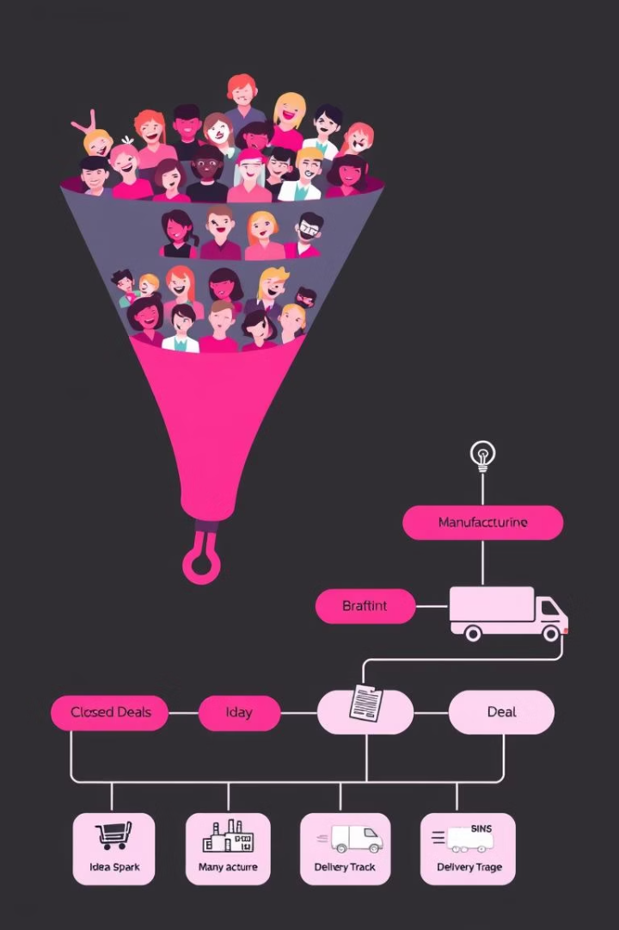
What Does TrackFlow Do?
Manage Sales Leads
Capture new leads, qualify their potential, and efficiently guide them to closing deals.
Streamline Orders
Handle the full order journey: receiving, building, dispatching, and tracking deliveries.

Slide 4
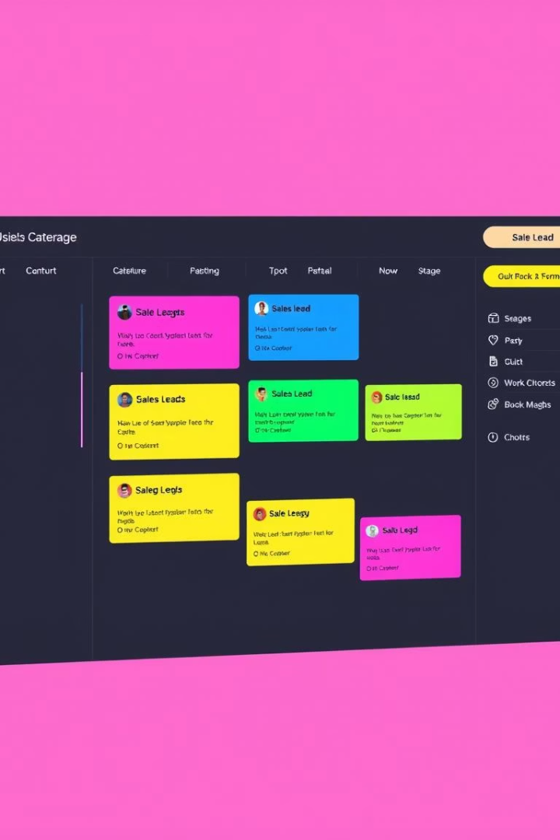




Core Features: Lead Management
Add New Leads
Capture contact and company information efficiently.
Assign Lead Stages
Progress leads through New, Contacted, Won/Lost stages.
Set Reminders
Automated follow-up reminders for timely engagement.
Flexible Views
Utilize Kanban and List views for adaptable lead tracking.

Slide 5

Core Features: Order Management
Convert Leads
Store Dispatch Info
Transform closed leads into new orders.
Record courier and tracking numbers for easy access.
1
2
3
Track Stages
Manually update order progress through custom stages.

Slide 6
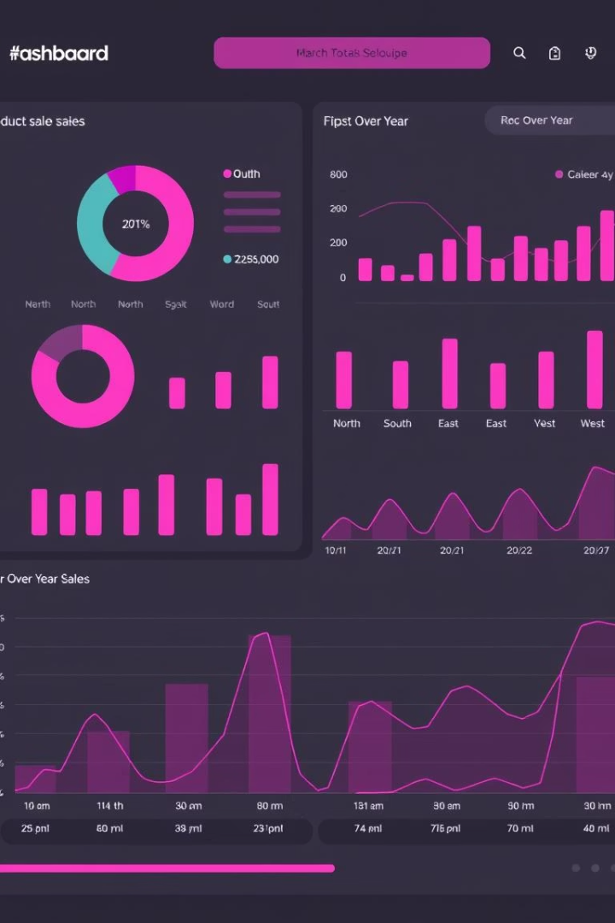
Dashboard & Tracking
147
Total Leads
Comprehensive overview of all leads.
23
Conversions
Successfully converted leads to orders.
18.5
Open Leads
Actively managed leads awaiting action.
8
Weekly Follow-ups
Upcoming tasks to engage with leads.

Slide 7
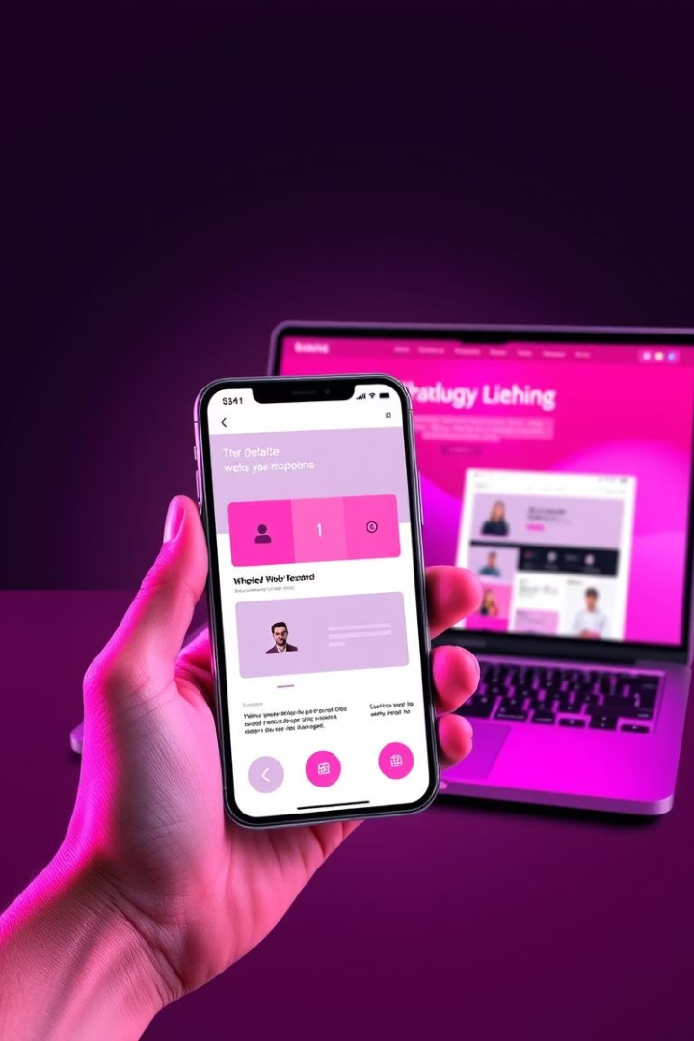




Bonus Features
Reminders & Notifications
Timely alerts for important tasks and follow-ups.
Document Uploads
Securely store invoices and proposals directly.
Basic Automation
Automate tasks like order generation for efficiency.
Fully Responsive
Seamless experience across all mobile devices.

Slide 8





TrackFlow Tech Stack
Frontend
Backend
Hosting
Vite, React, TypeScript, Tailwind CSS, shadcn-ui
FastAPI / Custom stack, PostgreSQL / Supabase / SQLite
Vercel (Frontend), Render/Railway (Backend)
Libraries
Chart.js for dashboard, FullCalendar for follow-ups

